Slide 1
Ball Jr. High School Incoming 7th Grade Parent Night
WEDNESDAY, FEBRUARY 11, 2015
6 p.m.
www.balljhs.org

Slide 2
Agenda
Introductions
Elementary vs. Junior High
Choosing Electives
Registration Card
Questions???

Slide 3
Introductions
Dr. Dabney-Lieras-Principal
Mrs. Houston-Assistant Principal A-L
Mr. Valeriano-Assistant Principal M-Z
Mr. Schwartz-Lead Counselor A-L
Ms. Mounger-Counselor M-Z
Ms. Dicono-Community Liaison

Slide 4
Elementary vs. Junior High
Elementary
1 teacher
1 classroom
Multiple subjects
2 recesses
Dress Code-Uniforms
400-1000 students
Junior High
7 teachers
7 classrooms
Multiple subjects
PE-no recess
Dress Code-Uniforms
4 min. passing periods
1000+ students

Slide 5
7th Grade Classes
All students take 7 classes:
-English
-Math
-World History
-Science
-PE
-2 Electives/Support Classes

Slide 6
What are Electives?
Electives are classes that the student gets to choose
ALL students will get 1 or 2 electives of their choice based on their need for extra support in English Language Arts (ELA)

Slide 7
English Classes
All students will take a grade level appropriate English class (English 7, English 7 HP)
The second English class, if appropriate, is a support class to help strengthen the Language Arts skills and to help prepare the student for high school. The focus of the class is on reading and writing.

Slide 8
Choosing Electives
Students need to pick their top 4 choices of electives
All electives are year-long
Consider each class and choose carefully
Descriptions of classes are on the “Elective Choices” sheet in the registration packet

Slide 9
Elective Choices
Art 1
Drama 1
Spanish for non-Spanish Speakers
Spanish for Spanish Speakers 1(must be a fluent Spanish speaker)
Choir 1 (Boy’s or Girl’s)
Journalism
Musical Theatre
Band 1
Memory Book
Elective Wheel (12 weeks of Computers, 12 weeks of Home Economics, 12 weeks of AVID)
Science Elective Wheel (9 weeks of Marine Biology, 9 weeks of Forensics, 9 weeks of Environmental Science and 9 weeks of Food Science)

Slide 10
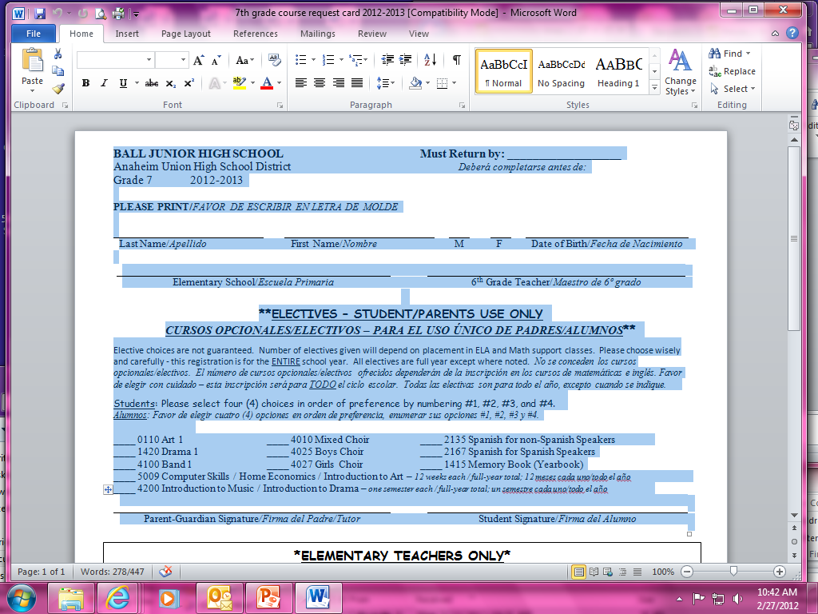
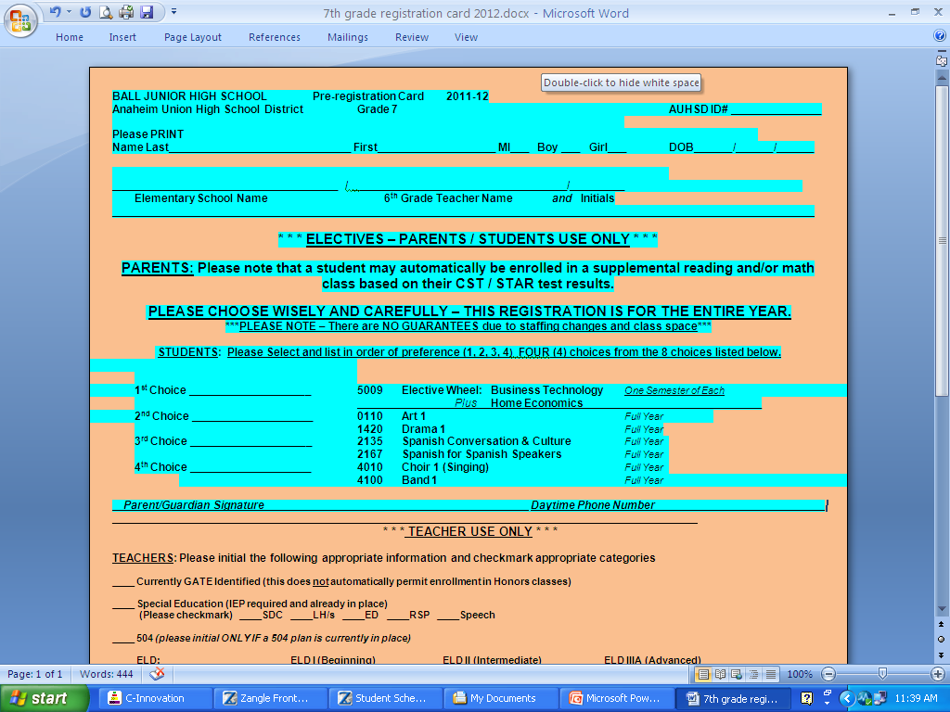
Don’t forget to sign!
Parents Sign Here

Slide 11
Registration Cards and Enrollment Forms are Due Back to the 6th Grade Teacher Please return your registration card and registration papers completely filled out and signed

Slide 12
Ball Basics….
School begins Wednesday, August 12, 2015
School days are 7:55-2:20 M,W,TH,F
Late Start days are 8:50-2:20 Tuesdays
Intramural Sports are offered after school. All students are encouraged to participate
A variety of clubs are offered for students to join
Homework Help Shop is offered before and after school
Anaheim Achieves is available on our campus
Check out our school website: www.balljhs.org

Slide 13
Elementary vs. Junior High
Elementary
1 teacher
1 classroom
Multiple subjects
2 recesses
Dress Code-Uniforms
400-1000 students
Junior High
7 teachers
7 classrooms
Multiple subjects
PE-no recess
Dress Code-Uniforms
4 min. passing periods
1000+ students

Slide 14
QUESTIONS?

